Slide 1
AMER case Study executive slides
-Swetha Kundurthi

Slide 2
The total number of approved forced outages are increased in 2017 than 2016. the proportion of outages that were forced in 2017 is increased than 2016.

Slide 3
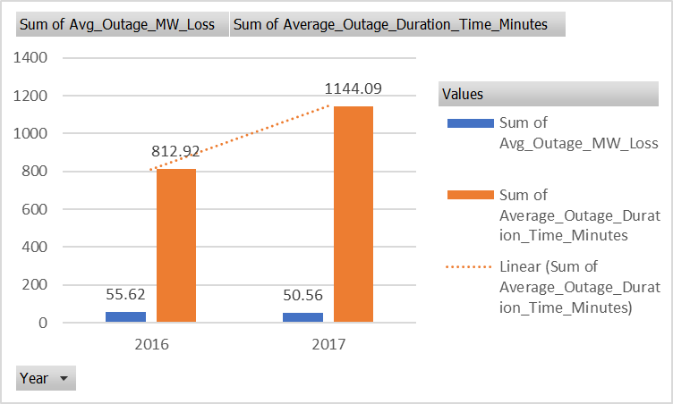
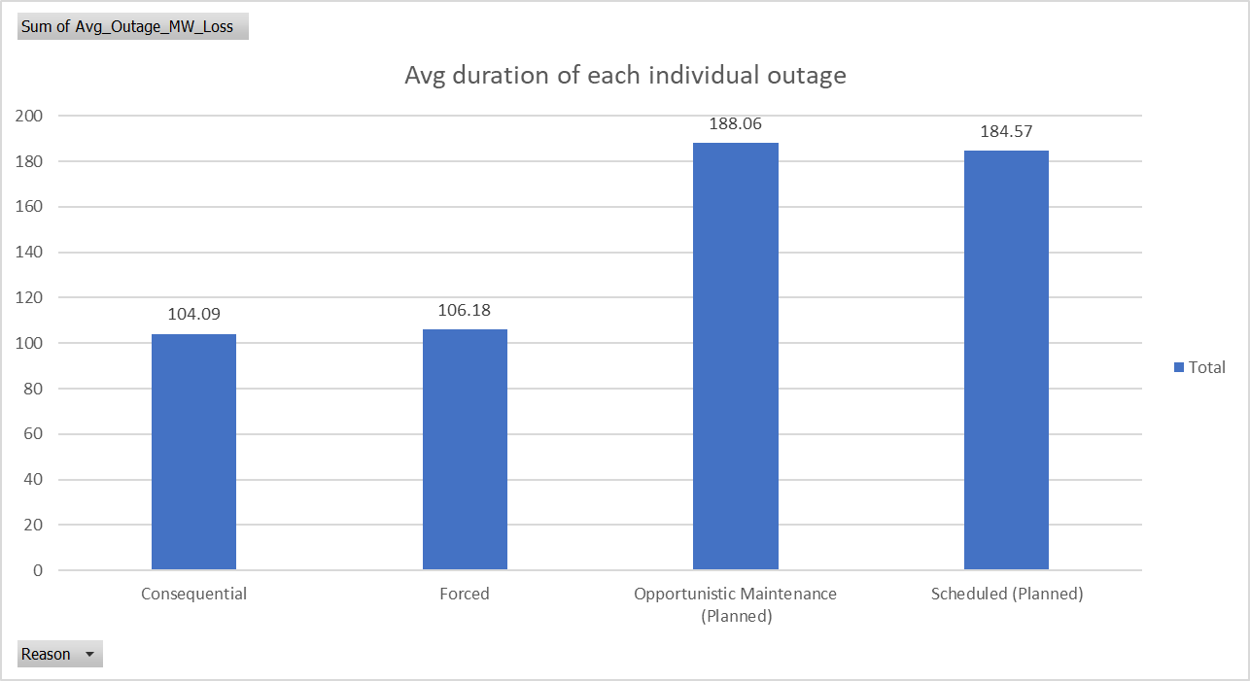
The average duration for a forced outage during both 2016 and 2017 are 812 and 1144 minutes respectively. And there is an increase in the average duration of forced outages from 2016 t0 2017. the highest average duration of minutes is opportunistic maintenance outage type.

Slide 4
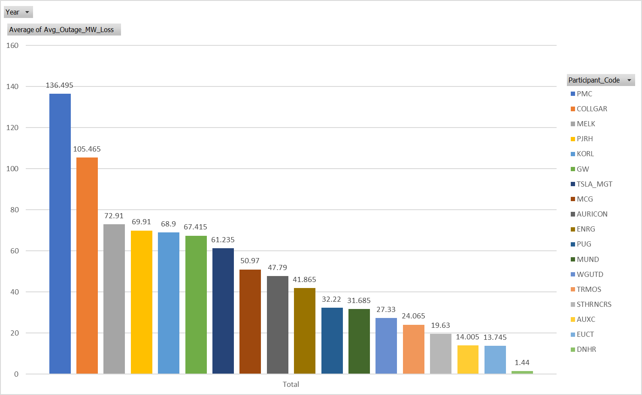
The most unreliable energy providers tend to be ENRG as it has the highest average duration outage time in days. The highest AVERAGE energy lost (MW) for all approved outages where the reason is Forced outage for PMC energy provider.

Slide 5
THANK YOU

